Slide 1
Introduction to Database Systems
Design Theory
(Ch. 3.1, 3.3-4)

Slide 2










Database Design Process
Conceptual Model:
name
product
makes
company
price
name
address
Relational Model: Tables + constraints And also functional dep.
Normalization: Eliminates anomalies
Conceptual Schema
Physical storage details
Physical Schema

Slide 3
Relational Schema Design
Name | SSN | PhoneNumber | City
Fred | 123-45-6789 | 206-555-1234 | Seattle
Fred | 123-45-6789 | 206-555-6543 | Seattle
Joe | 987-65-4321 | 908-555-2121 | Westfield
One person may have multiple phones, but lives in only one city
Primary key is thus (SSN, PhoneNumber) What is the problem with this schema?

Slide 4



Relational Schema Design
Name | SSN | PhoneNumber | City
Fred | 123-45-6789 | 206-555-1234 | Seattle
Fred | 123-45-6789 | 206-555-6543 | Seattle
Joe | 987-65-4321 | 908-555-2121 | Westfield
These can cause bugs!
Worry most about later two.
Anomalies:
Redundancy = repeat data
Update anomalies = what if Fred moves to “Bellevue”?
Deletion anomalies = what if Joe deletes his phone number?

Slide 5
Relation Decomposition
Break the relation into two:
Name | SSN | PhoneNumber | City
Fred | 123-45-6789 | 206-555-1234 | Seattle
Fred | 123-45-6789 | 206-555-6543 | Seattle
Joe | 987-65-4321 | 908-555-2121 | Westfield
Name | SSN | City
Fred | 123-45-6789 | Seattle
Joe | 987-65-4321 | Westfield
SSN | PhoneNumber
123-45-6789 | 206-555-1234
123-45-6789 | 206-555-6543
987-65-4321 | 908-555-2121
Anomalies have gone:
No more repeated data
Easy to move Fred to “Bellevue” (how ?)
Easy to delete all Joe’s phone numbers (how ?)

Slide 6
Relational Schema Design (or Logical Design)
How do we do this systematically?
Start with some relational schema
Find out its functional dependencies (FDs)
Use FDs to normalize the relational schema

Slide 7
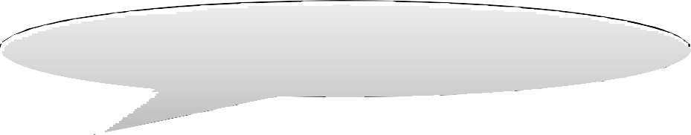


Functional Dependencies (FDs)
Definition
If two tuples agree on the attributes
A₁, A₂, …, A_{n}
then they must also agree on the attributes
B₁, B₂, …, B_{m}
Formally:
A₁…A_{n} determines B₁...B_{m}
A₁, A₂, …, A_{n} → B₁, B₂, …, B_{m}

Slide 8
Functional Dependencies (FDs)
Definition FD A₁, ..., A_{m} → B₁, ..., B_{n} holds in R if: for every pair of tuples t, t’ ∈ R,
(t.A₁ = t’.A₁ and ... t.A_{m} = t’.A_{m} → t.B₁ = t’.B₁ and ... t.B_{n} = t’.B_{n} )
R
t
 | A₁ | ... | A_{m} |  | B₁ | ... | B_{n}
t’
if t, t’ agree here then t, t’ agree here

Slide 9
Example
An FD holds, or does not hold on an instance:
EmpID | Name | Phone | Position
E0045 | Smith | 1234 | Clerk
E3542 | Mike | 9876 | Salesrep
E1111 | Smith | 9876 | Salesrep
E9999 | Mary | 1234 | Lawyer
EmpID → Name, Phone, Position Position → Phone
but not Phone → Position

Slide 10
Example
EmpID | Name | Phone | Position
E0045 | Smith | 1234 | Clerk
E3542 | Mike | 9876 ← | Salesrep
E1111 | Smith | 9876 ← | Salesrep
E9999 | Mary | 1234 | Lawyer
Position → Phone

Slide 11
Example
EmpID | Name | Phone | Position
E0045 | Smith | 1234 → | Clerk
E3542 | Mike | 9876 | Salesrep
E1111 | Smith | 9876 | Salesrep
E9999 | Mary | 1234 → | Lawyer
But not Phone → Position

Slide 12
Example
name → color
category → department color, category → price
name | category | color | department | price
Gizmo | Gadget | Green | Toys | 49
Tweaker | Gadget | Green | Toys | 99
Do all the FDs hold on this instance?

Slide 13

Example
name → color
category → department color, category → price
name | category | color | department | price
Gizmo | Gadget | Green | Toys | 49
Tweaker | Gadget | Green | Toys | 49
Gizmo | Stationary | Green | Office-supp. | 59
What about this one ?

Slide 14
Terminology
FD holds or does not hold on an instance
If we can be sure that every instance of R will be one in which a given FD is true, then we say that R satisfies the FD
If we say that R satisfies an FD F, we are
stating a constraint on R (part of schema)

Slide 15

An Interesting Observation
name → color
category → department color, category → price
If all these FDs are true:
Then this FD also holds:
name, category → price
If we find out from application domain that a relation satisfies some FDs, it doesn’t mean that we found all the FDs that it satisfies!
There could be more FDs implied by the ones we have.

Slide 16
Closure of a set of Attributes
Given a set of attributes A₁, …, A_{n},
The closure {A₁, …, A_{n}}⁺ = the set of attributes B
s.t. A₁, …, A_{n} → B
Example:
name → color
category → department
color, category → price
Closures:
name⁺ = {name, color}
{name, category}⁺ = {name, category, color, department, price} color⁺ = {color}

Slide 17
Closure Algorithm
X={A1, …, An}.
Example:
Repeat until X doesn’t change do: if B₁, …, B_{n} → C is a FD and
name → color
category → department
color, category → price
B₁, …, B_{n} are all in X
then add C to X.
{name, category}⁺ =
{ name, category, color, department, price }
Hence: name, category → color, department, price

Slide 18
Example
In class:
R(A, B, C, D, E, F)
A, B → C A, D → E
B → D A, F → B
Compute {A, B}⁺
X = {A, B,
}
Compute {A, F}⁺
X = {A, F,
}

Slide 19
Example
In class:
R(A, B, C, D, E, F)
A, B → C A, D → E
B → D A, F → B
Compute {A, B}⁺
X = {A, B, C, D, E }
Compute {A, F}⁺
X = {A, F,
}

Slide 20


Example
In class:
R(A, B, C, D, E, F)
A, B → C A, D → E
B → D A, F → B
Compute {A, B}⁺
Compute {A, F}⁺
X = {A, B, C, D, E }
X = {A, F, B, C, D, E }
What is a key of R?

Slide 21
Practice at Home
Find all FD’s implied by:
A, B | → | C
A, D | → | B
B | → | D

Slide 22
Practice at Home
Find all FD’s implied by:
A, B | → | C
A, D | → | B
B | → | D
Step 1: Compute X⁺, for every X:
A⁺ = A, B⁺ = BD, C⁺ = C, D⁺ = D AB⁺ = ABCD, AC⁺= AC, AD⁺ = ABCD,
BC⁺ = BCD, BD⁺ = BD, CD⁺ = CD
ABC⁺ = ABD⁺ = ACD⁺ = ABCD (no need to compute – why?) BCD⁺ = BCD, ABCD⁺ = ABCD
Step 2: Enumerate all FD’s X → Y s.t. Y ⊆ X⁺ and X∩Y = ∅:
AB → CD, AD→BC, ABC → D, ABD → C, ACD → B

Slide 23
Keys
A superkey is a set of attributes A₁, ..., A_{n} s.t. for any other attribute B, we have A₁, ..., A_{n} → B
A key is a minimal superkey
– superkey and for which no subset is a superkey

Slide 24
Computing (Super)Keys
For all sets X, compute X⁺
If X⁺ = [all attributes], then X is a superkey
Try only the minimal X’s to get the key

Slide 25
Example
Product(name, price, category, color)
name, category → price
category → color
What is the key?
{name, category} + = { name, category, price, color }
Hence {name, category} is a (super)key

Slide 26

Key or Keys?
Can we have more than one key?
Given R(A, B, C), define FD’s s.t. there are two or more keys
A → B B → C C → A
AB→C BC→A
A→BC B→AC
or
or
what are the keys here ?

Slide 27
Eliminating Anomalies
Main idea:
X → A is OK if X is a (super)key
X → A is not OK otherwise
– Need to decompose the table, but how?
Boyce-Codd Normal Form

Slide 28
Normal Forms
First Normal Form
Every attribute is singled value attribute
Second Normal Form
No partial dependency
Third Normal Form
No transitive dependency
Boyce-Codd Normal Form
Every non-trivial functional dependency X –> Y, X is a super key

Slide 29
Boyce-Codd Normal Form
There are no “bad” FDs:
Definition. A relation R is in BCNF if:
Whenever X→ A is a non-trivial dependency, then X is a superkey.
Equivalently:
Definition. A relation R is in BCNF if:
∀ X, either X⁺ = X or X⁺ = [all attributes]

Slide 30
BCNF Decomposition Algorithm
Normalize(R)
find X s.t.: X ≠ X⁺ and X⁺ ≠ [all attributes]
if (not found) then “R is in BCNF”
let Y = X⁺ - X; Z = [all attributes] - X⁺ decompose R into R1(X ∪ Y) and R2(X ∪ Z) Normalize(R1); Normalize(R2);
Y
X Z
_{X}+
32

Slide 31
Example
Name | SSN | PhoneNumber | City
Fred | 123-45-6789 | 206-555-1234 | Seattle
Fred | 123-45-6789 | 206-555-6543 | Seattle
Joe | 987-65-4321 | 908-555-2121 | Westfield
Joe | 987-65-4321 | 908-555-1234 | Westfield
SSN → Name, City
Name, City
Phone-
SSN
Number
The only key is: {SSN, PhoneNumber}
Hence SSN → Name, City is a “bad” dependency
In other words:
SSN⁺
SSN⁺ = SSN, Name, City and is neither SSN nor All Attributes
31

Slide 32
Example BCNF Decomposition
Name | SSN | City
Fred | 123-45-6789 | Seattle
Joe | 987-65-4321 | Westfield
SSN → Name, City
Name, City
Phone-
SSN
SSN | PhoneNumber
123-45-6789 | 206-555-1234
123-45-6789 | 206-555-6543
987-65-4321 | 908-555-2121
987-65-4321 | 908-555-1234
Number
SSN⁺
Let’s check anomalies:
Redundancy ?
Update ?
Delete ?
32

Slide 33
Find X s.t.: X ≠X⁺ and X⁺ ≠ [all attributes]
Example BCNF Decomposition
Person(name, SSN, race, hairColor, phoneNumber)
SSN → name, race race → hairColor
33

Slide 34
Find X s.t.: X ≠X⁺ and X⁺ ≠ [all attributes]
Example BCNF Decomposition
Person(name, SSN, race, hairColor, phoneNumber)
SSN → name, race race → hairColor
Iteration 1: Person: SSN⁺ = SSN, name, race, hairColor Decompose into: P(SSN, name, race, hairColor)
Phone(SSN, phoneNumber)
name, race, hairColor
phoneNumber
SSN
34

Slide 35



Find X s.t.: X ≠X⁺ and X⁺ ≠ [all attributes]
Example BCNF Decomposition
Person(name, SSN, race, hairColor, phoneNumber)
SSN → name, race race → hairColor
What are the keys ?
Iteration 1: Person: SSN⁺ = SSN, name, race, hairColor Decompose into: P(SSN, name, race, hairColor)
Phone(SSN, phoneNumber)
Iteration 2:
P: race⁺ = race, hairColor
Decompose: People(SSN, name, race)
Hair(race, hairColor) Phone(SSN, phoneNumber)
35

Slide 36
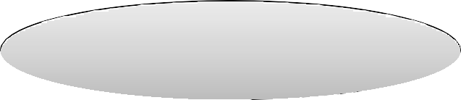

Find X s.t.: X ≠X⁺ and X⁺ ≠ [all attributes]
Example BCNF Decomposition
Person(name, SSN, race, hairColor, phoneNumber)
SSN → name, race race → hairColor
Note the keys!
Iteration 1: Person: SSN⁺ = SSN, name, race, hairColor Decompose into: P(SSN, name, race, hairColor)
Phone(SSN, phoneNumber)
Iteration 2:
P: race⁺ = race, hairColor
Decompose: People(SSN, name, race)
Hair(race, hairColor) Phone(SSN, phoneNumber)
36

Slide 37
R(A, B, C, D)
A → B B → C
Example: BCNF
R(A, B, C, D)
37

Slide 38

R(A, B, C, D)
Example: BCNF
Recall: find X s.t.
A → B B → C
_{X}+
X [all-attrs]
R(A, B, C, D)
38

Slide 39
R(A, B, C, D)
A → B B → C
Example: BCNF
R(A, B, C, D) A⁺ = ABC ≠ ABCD
39

Slide 40
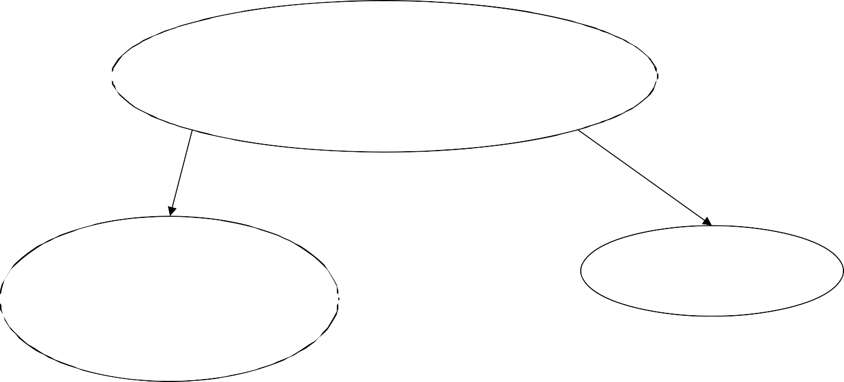
R(A, B, C, D)
A → B B → C
Example: BCNF
R(A, B, C, D) A⁺ = ABC ≠ ABCD
R₁(A, B, C)
R₂(A, D)
40

Slide 41
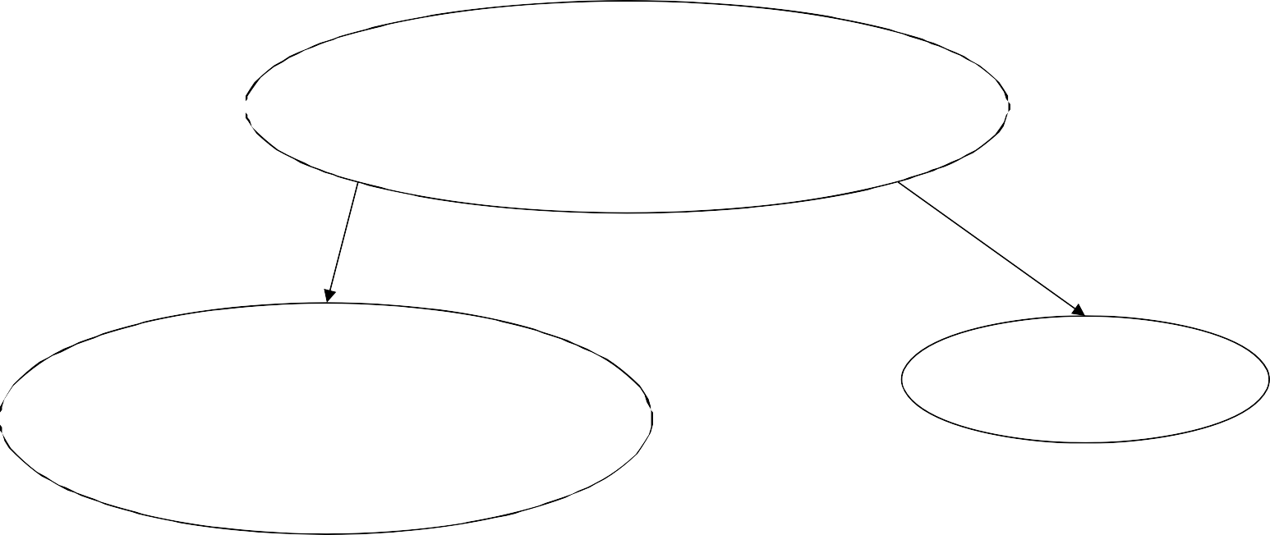
R(A, B, C, D)
Example: BCNF
R(A, B, C, D) A⁺ = ABC ≠ ABCD
A → B B → C
R₁(A, B, C) B⁺ = BC ≠ ABC
R₂(A, D)
41

Slide 42
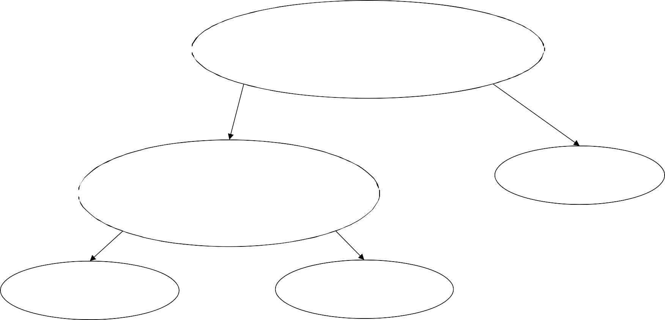



R(A, B, C, D)
Example: BCNF
R(A, B, C, D) A⁺ = ABC ≠ ABCD
A → B B → C
R₁(A, B, C) B⁺ = BC ≠ ABC
R₂(A, D)
What are the keys ?
R₁₁(B, C)
R₁₂(A, B)
What happens if in R we first pick B⁺ ? Or AB⁺ ?
42

Slide 43
Decompositions in General
R(A₁, ..., A_{n}, B₁, ..., B_{m}, C₁, ..., C_{p})
S₁(A₁, ..., A_{n}, B₁, ..., B_{m})
S₂(A₁, ..., A_{n}, C₁, ..., C_{p})
S₁ = projection of R on A₁, ..., A_{n}, B₁, ..., B_{m} S₂ = projection of R on A₁, ..., A_{n}, C₁, ..., C_{p}
43

Slide 44
Lossless Decomposition
name → price, but not category
Name | Price | Category
Gizmo | 19.99 | Gadget
OneClick | 24.99 | Camera
Gizmo | 19.99 | Camera
Name | Price
Gizmo | 19.99
OneClick | 24.99
Gizmo | 19.99
Name | Category
Gizmo | Gadget
OneClick | Camera
Gizmo | Camera
44

Slide 45


Lossy Decomposition
What is lossy here?
Name | Price | Category
Gizmo | 19.99 | Gadget
OneClick | 24.99 | Camera
Gizmo | 19.99 | Camera
Name | Category
Gizmo | Gadget
OneClick | Camera
Gizmo | Camera
Price | Category
19.99 | Gadget
24.99 | Camera
19.99 | Camera
45

Slide 46
Lossy Decomposition
Name | Price | Category
Gizmo | 19.99 | Gadget
OneClick | 24.99 | Camera
Gizmo | 19.99 | Camera
Name | Category
Gizmo | Gadget
OneClick | Camera
Gizmo | Camera
Price | Category
19.99 | Gadget
24.99 | Camera
19.99 | Camera
46

Slide 47

Decomposition in General
R(A₁, ..., A_{n}, B₁, ..., B_{m}, C₁, ..., C_{p})
S₁(A₁, ..., A_{n}, B₁, ..., B_{m})
S₂(A₁, ..., A_{n}, C₁, ..., C_{p})
Let:
S₁ = projection of R on A₁, ..., A_{n}, B₁, ..., B_{m}
S₂ = projection of R on A₁, ..., A_{n}, C₁, ..., C_{p}
The decomposition is called lossless if R = S₁ S₂
Fact: If A₁, ..., A_{n} → B₁, ..., B_{m} then the decomposition is lossless
It follows that every BCNF decomposition is lossless
47

Slide 48
Schema Refinements
= Normal Forms
1st Normal Form = all tables are flat (no list values)
2nd Normal Form = obsolete
Boyce Codd Normal Form = no bad FDs
3rd Normal Form = see book
BCNF is lossless but can cause lose ability to check some FDs without a join (see book 3.4.4)
3NF fixes that (is lossless and dependency-preserving), but some tables might not be in BCNF – i.e., they may have redundancy anomalies
48

